Slide 1
Web Project Management
Web Engineering

Slide 2
Software Project Management
Software project management supports an engineering approach to software development.
It extends the technical product development cycle (planning – implementing – checking) to economic and social tasks, like managing, developing, and monitoring.
Main aim to have an iterative controlled process of software development

Slide 3
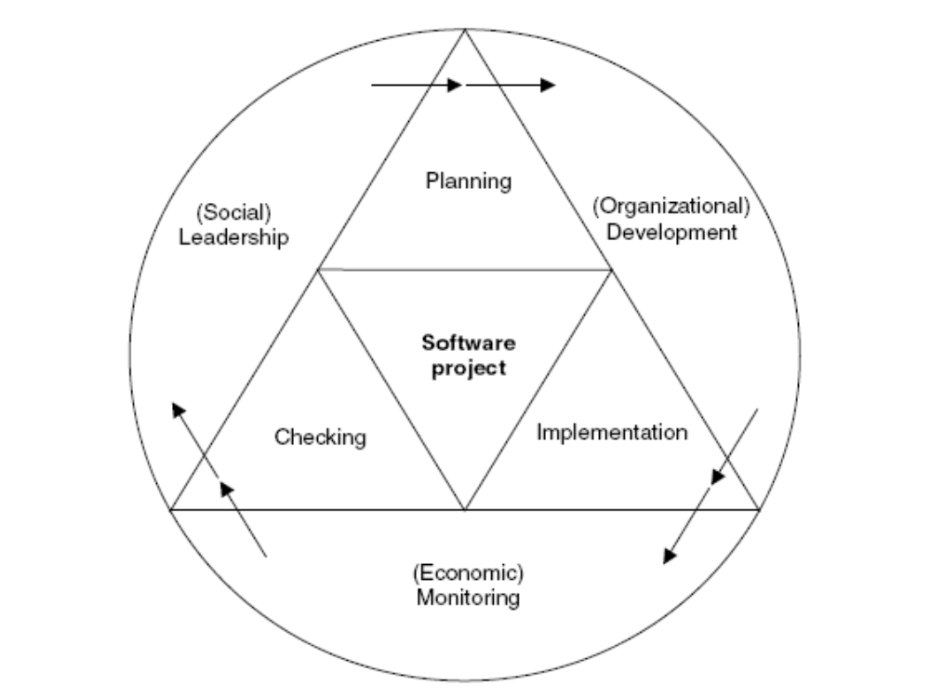
Figure: Project management objective: an engineering approach to software development

Slide 4
Software Project Management Tasks
A project is an innovative and complex undertaking with conditions, such as costs, deadlines, resources, and quality.
Software project management includes the following tasks:
  Leadership: Organize, control, lead staff, inform.
  Development: Set, plan, and define objectives.
  Monitoring: Check and control.

Slide 5
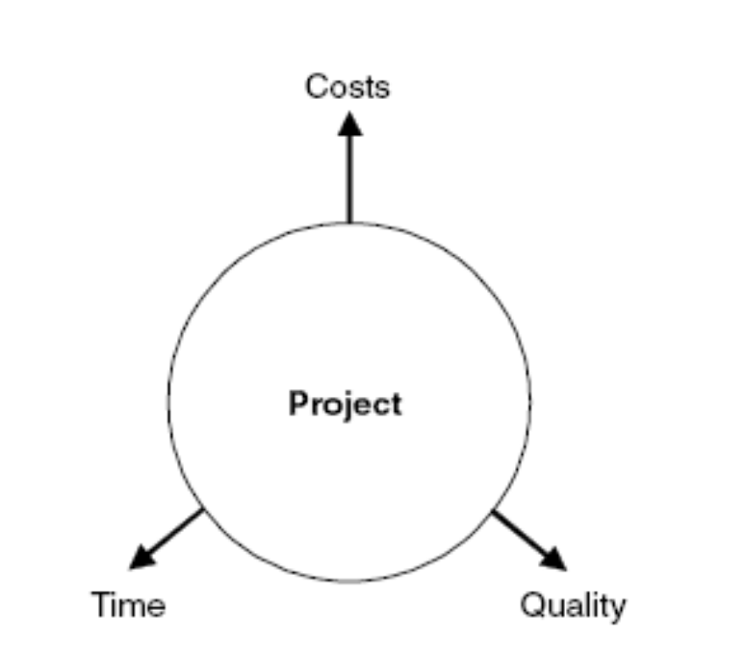
Conflicting areas in project

Slide 6
Specifics of Web Project Management
Parameter | Software Project Management | Web Project Management
Main objective | Create a quality product at lowest possible cost! | Create a usable product in shortest possible time!
Project size | Medium to large (10 to 100 people and more) | Usually small (6 +/− 3 people)
Duration | 12 to 18 months on average | 3 to 6 months on average
Cost | several million dollars | several thousand dollars
Development Approach | Based on requirements; structured into phases; incremental; documentation-driven | Agile methods; assembly of components; prototyping

Slide 7
Specifics of Web Project Management ..
Parameter | Software Project Management | Web Project Management
Technologies | OO methods, CASE tools | Components-based methods; visual programming; multimedia
Processes | CMM, ISO, etc. (“rigid”) | ad-hoc (“agile”)
Product | Code-based; poor reusability; complex applications | High reusability; standard components; many standard applications
Staff Profile | Professional software developers with several years of experience | Multimedia designers; Web programmers (Java, etc.); PR/marketing people

Slide 8
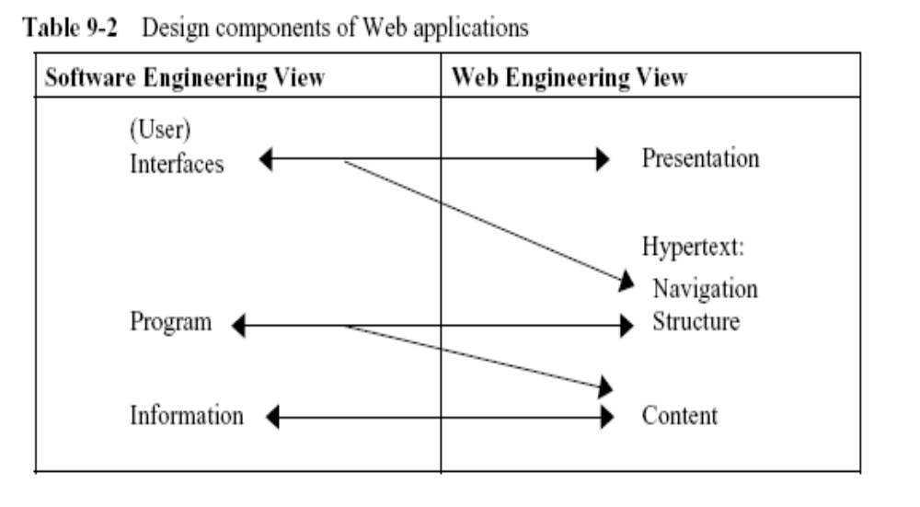
Design Component of Web Applications

Slide 9
Challenges in Web Project Management
General Challenges
Leadership Challenges
    Unique software systems
    Extremely technical leadership perspective
    Poor planning
Development Challenges
  Individuality of programmers
  High number of alternative solutions
  Rapid technological change
Monitoring Challenges
  The immaterial state of software products

Slide 10
Development-related Challenges
Novelty
  Many Web applications are designed to address a new or unknown user group
  Confrontation of the development team with the new and changing requirements of the Web applications
Dynamics
  Due to high-time to market pressure there is very short development cycles
  Web applications have short lifecycles and a very high update frequency

Slide 11
Development-related Challenges ..
Parallelism
  Web applications are developed by subgroups in parallel
  Reason for this is:
    short development cycle and
    component-based structure of the application domain (e.g., authentication, similarity search, news ticker, chat room)
  Sub-teams in Web projects need high level of communication.

Slide 12
Development-related Challenges ..
Continuity
  Continuous evolution is an important characteristic of the Web applications and Web itself
  Often the team has to decide to freeze the development of an increment and release it with some minimum set of functionality
  Often the time between the releases is of few weeks
  Maintenance therefore, is an ongoing job with fixes released per increment and whenever required

Slide 13
Development-related Challenges ..
Juvenility
  Web application developers are much younger and less experiences
  High interest in new tools and technologies without any foundation of existing knowledge and practices
  Web project management is responsible for utilizing the enthusiasm of its staff to select suitable technologies and tools.

Slide 14
Development-related Challenges ..
Immaturity
  Many Web application environments are constantly updated or changed to:
    To remove errors
    Interface expansion, etc.
  Extremely fast pace of technological development leads to poor experience with tools is poor
  leads to a considerable hindrance of a Web application’s evolution
  experience and knowledge are lost or not built in the first place

Slide 15
Product-related Challenges in Web Projects
Apparent Simplicity
First impression about Web development is its simplicity or low level of difficulty
May be true for static hypertext pages
Just-in-Time creation of Web pages from different data sources is a complex job

Slide 16
Product-related Challenges ..
Aesthetics
  The Web (or rather, its applications) is referred to as the “most fashion-aware software”.
  To “Stay in” the look of the Web application has to be updated constantly
  Critical success factor of a Web Application

Slide 17
Product-related Challenges ..
Spontaneity
  People only use a Web application when they see a direct benefit in its use
  the use of a Web application has to be (widely) possible without instructions!
  Good usability is a critical success factor for Web applications, which cannot be stressed enough in the planning phase.
  Web project management should specifically focus on managing various usability tests and giving enough time for these kind of tests.

Slide 18
Product-related Challenges ..
Ubiquity
  a wide range of user groups and the target devices are available for Web applications
  Testing a Web application on different devices/platforms thus becomes difficult
  The collection and validation of requirements based on different user groups and devices is clearly more difficult for Web applications
  This increases the level of insecurity faced by Web project management.

Slide 19
Development-related Challenges ..
Compatibility
  Different browsers have different compatibility behaviour and unclear support for different standards
  Moreover, browsers are highly configurable in terms of look and feel and functionality
  A solution that would allow Web project management a certain security in development doesn’t appear to be forthcoming in this respect.

Slide 20
Product-related Challenges ..
Stability and Security
  Web applications to be available 24x7
  High requirements for quality in terms of reliability as well as the underlying IT infrastructure (hardware and NW connections)
  Maintenance thus, becomes a challenge
  Maintenance has to be performed either on a production system or on a backup/parallel system
  Management has to work hard on the issues of synch. of maintenance versions with the actual deployed system

Slide 21
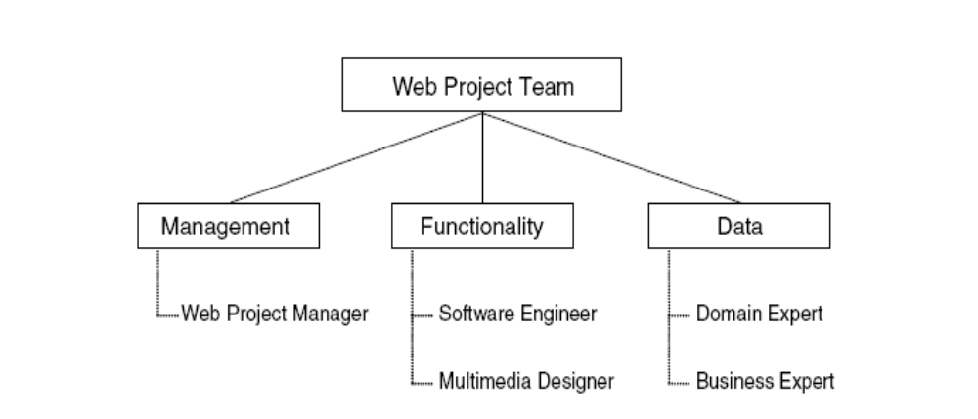
Web Project Team
Teams have three important characteristics
  Multidisciplinary
  Parallelism
  Small size

Slide 22
Web Project (WP) Manager
Key task: is that he or she has to lead a team composed of people with different abilities and competencies.
Organisational challenges faced by a WP Manager were discussed in development related challenges
technical challenges were discussed in product-related challenges
Besides the above, WP Manager also has to deal with social challenges

Slide 23
Social challenges faced by WP Manager
Inspire all project members with the project objectives.
Be capable of leading a multidisciplinary team.
Create the willingness and readiness for (democratic) cooperation.
Constantly motivate the team and solve conflicts.

Slide 24
Rules for Web Project Manager
Promote the professional self-conception of each team member. Take care of ethics in the team.
Stress the importance of different application knowledge for the project.
Solve conflicts quickly. Make sure no team member is a winner or a loser all the time.
Explain to each team member his or her roles and responsibilities continuously.
Identify parallel developments and utilize potential synergies.

Slide 25
Rules for Web Project Manager
Distribute documentation tasks to team members fairly according to their scope.
Promote and coordinate the continuous use of tools from the very beginning of the project.
Translate costs and values into different project areas.
Promote the continuous integration of the customer in the project.
Always keep an eye on the project progress and the project objective.

